Slide 1
Electronics & Electricity
Unit 6 – TinkerCAD Circuits
Section 1 – TinkerCAD Circuits

Slide 2
TinkerCAD Circuits
TinkerCAD Circuits

Slide 3
The big idea
Familiarity with TinkerCAD
Designed circuits in a virtual environment
Ohm’s Law practice

Slide 4
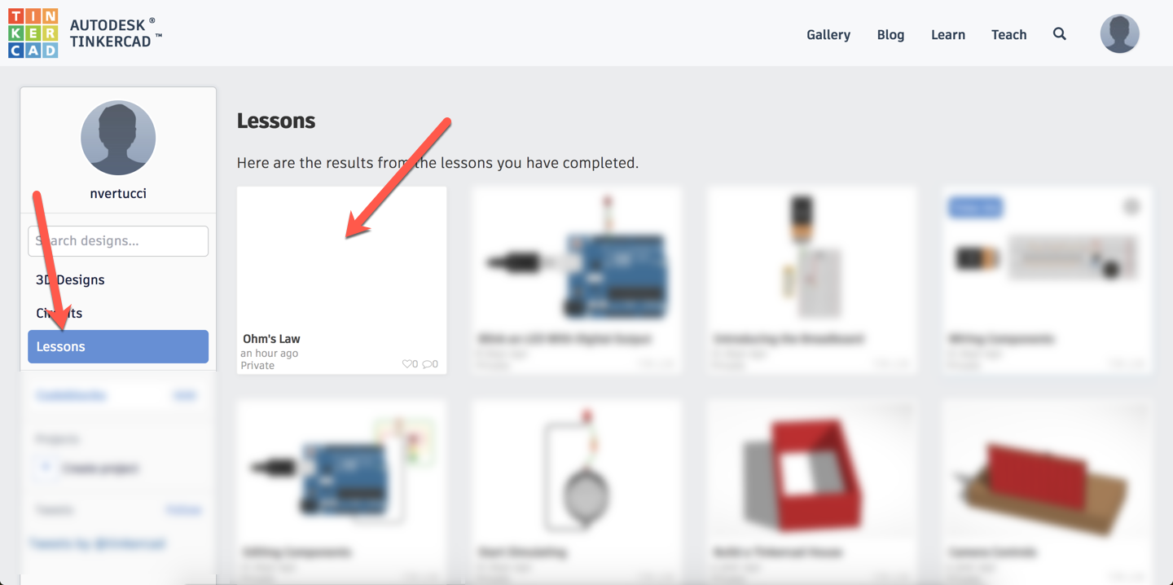
TinkerCAD Circuits

Slide 5
TinkerCAD Circuits – Ohm’s Law
Work in groups of 2
Log into one students TinkerCAD account
Find the lessons area within your profile
Select the Ohm’s Law lesson
Complete the lesson and share a snapshot of the assignment to google classroom

